Slide 1
Week 2 Topics Presentation

Slide 2
Available IDEs and Stores for publishing
IDEs:
Android: Android Studio, Visual Studio – Xamarin, Unreal Engine, PhoneGap, Corona, CppDroid, AIDE, IntelliJ IDEA.
iOS: Xcode, Swift and Appcode
(Swift: Swift is a general-purpose, multi-paradigm, compiled programming language developed by Apple Inc. for iOS, macOS, watchOS, tvOS, Linux and z/OS. Xcode is I DE, Swift is language)
Windows: Visual Studio
Stores:
Android: Play store, Amazon Appstore, Mobogenie, 1Mobile, SlideME
iOS: Apple store
Windows: Windows store

Slide 3

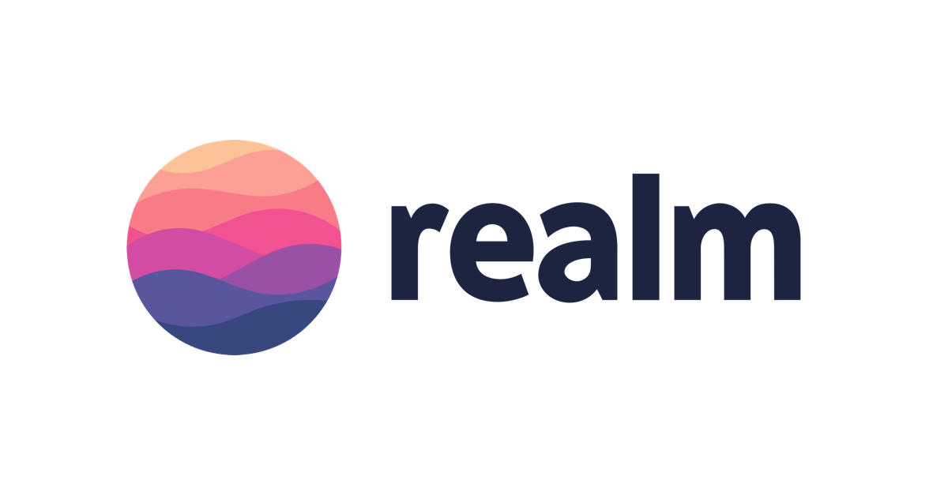

Offline Databases
Offline databases are used to store information/ store copies of remote databases inside the device itself for modification when the device is disconnected.
Later when connection is established it can be synced with the online one.
Eg. SQLite, Realm DB, ORMLite, CouchDB

Slide 4
Mobile App Security Threats
Hackers with malicious intent can:
Inject malware into apps and onto devices where it can access data, store keystrokes, and steal screen lock passcodes
Tamper with or copy your app’s code and reverse-engineer a spoof app containing malware
Intercept sensitive information traveling over the airwaves
Steal customer data for identity theft or fraud purposes
Get hold of intellectual property and private business assets
Access your IP or compromise your company’s back-end network

Slide 5
Security Measures
SECURE YOUR APP’S CODE FROM THE GROUND UP. (encrypt app code by obfuscation or minification)
Obfuscation: obfuscation is the deliberate act of creating source or machine code that is difficult for humans to understand. Like obfuscation in natural language, it may use needlessly roundabout expressions to compose statements.
Eg. PHP – Base64, eval(), GLOBAL()
Javascript – Base64, EVAL
SECURE YOUR NETWORK CONNECTIONS ON THE BACK END. (CONTAINERIZATION, VPN, SSL)
PUT IDENTIFICATION, AUTHENTICATION, AND AUTHORIZATION MEASURES IN PLACE. (OAUTH2, JSON WEB TOKENS, OPENID CONNECT)
BE MINDFUL OF HOW CUSTOMER DATA IS SECURED AND IMPLEMENT A GOOD MOBILE ENCRYPTION POLICY. (FILE LEVEL ENCRYPTION, DATABASE ENCRYPTION, KEY MANAGEMENT)
HAVE A SOLID API SECURITY STRATEGY IN PLACE. (identification, authentication, authorization)
TEST YOUR APP SOFTWARE—THEN TEST AGAIN. (PENETRATION TESTING)
USERS: PROTECT YOUR DEVICES. (DON’T ROOT OR JAILBREAK AS IT NEGATES THE BUILT IN SECURITY MEASURES AND HENCE YOUR DEVICE BECOMES VULNERABLE)
IF YOU’RE AN ENTERPRISE ORGANIZATION WITH A BYOD (BRING YOUR OWN DEVICE) POLICY, USE EXTRA CAUTION.

Slide 6
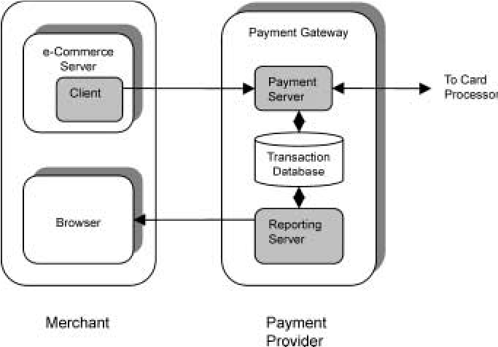
Payment Gateway
What?
Gateway that authorises credit card or direct payments processing for
merchant.
Methods:
India:
Banking cards, USSD (Unstructured Supplementary Service Data), Aadhaar Enabled Payment System (AEPS), UPI (Unified Payments Interface), Mobile Wallets, Bank prepaid cards, Internet Banking, Mobile Banking, Bharat Interface for Money (BHIM) app
Abroad:
Credit cards, bank and mobile transfers, EWallets, Direct Deposit

Slide 7
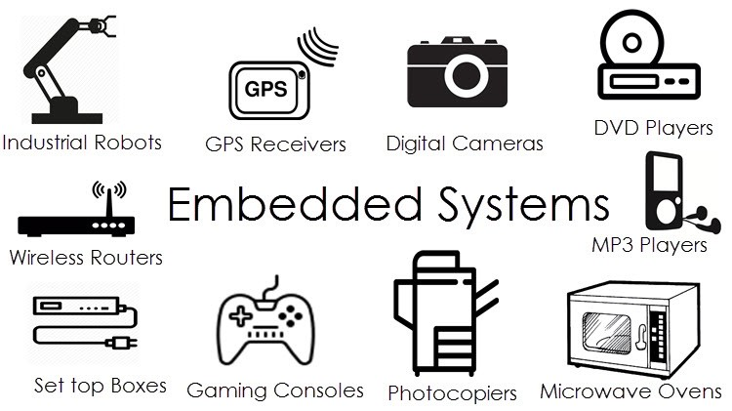
Embedded Systems
What?
An embedded system is a programmed controlling and operating system with a dedicated function within a larger mechanical or electrical system, often with real-time computing constraints.
It is used in cars, bikes, etc
Eg. Systems that calculate distance travelled, GPS, etc
Languages used - C, C++, Python and Rust

Slide 8
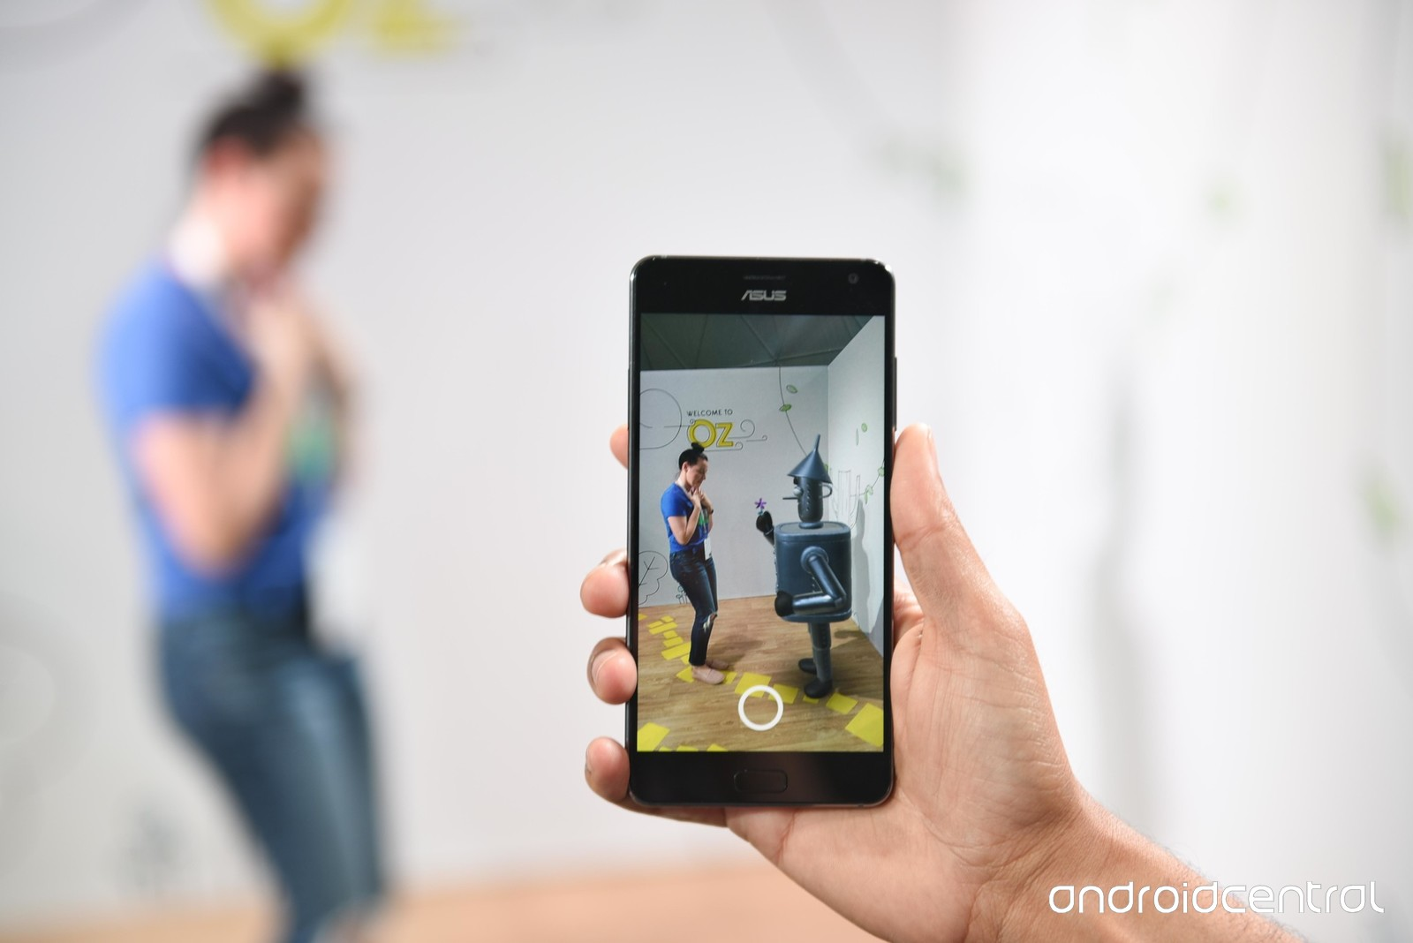
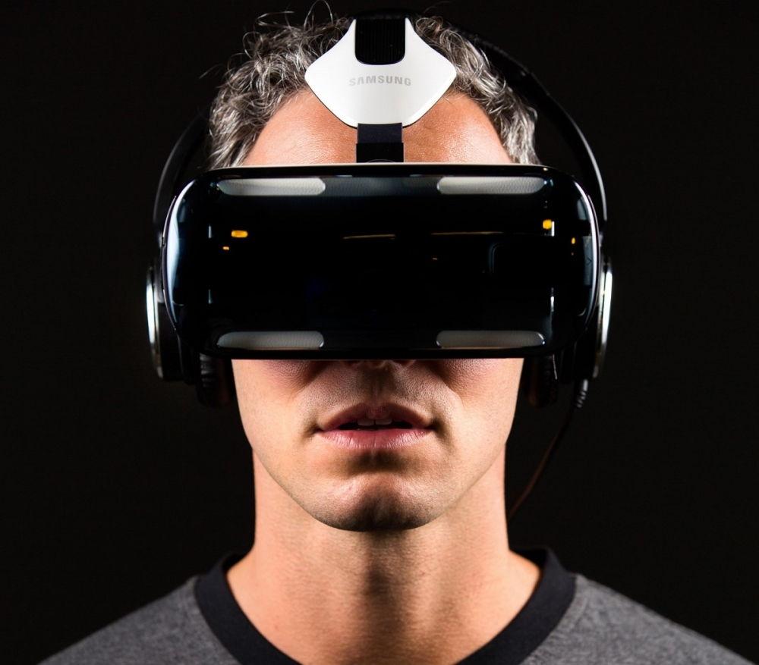
AR and VR
What?
AR - Augmented reality (AR) is an interactive experience of a real-world environment where the objects that reside in the real-world are "augmented" by computer-generated perceptual information, sometimes across multiple sensory modalities, including visual,auditory, haptic, somatosensory, and olfactory
Eg. Google Sky Map, AcrossAir - AR browser, PokemonGo, Layar - AR interactive browser, Lookator - AR hotspot detector, SpotCrime - AR crime site
VR - Virtual reality (VR) is an interactive computer-generated experience taking place within a simulated environment. It incorporates mainly auditory and visual feedback, but may also allow other types of sensory feedback like haptic
Eg. Microsoft HoloLens, Vive by valve, Oculus Rift, Oculus VR
Difference is that AR alters pre existing reality using a camera and displays in a screen whereas VR shows a completely virtual reality using a headset

Slide 9
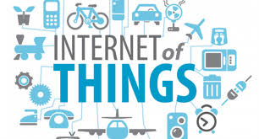
IoT - Internet of Things
What?
It is the network of devices, vehicles, and home appliances that contain electronics, software, actuators, and connectivity which allows these things to connect, interact and exchange data. It is used to make products ‘SMART’
Uses - Smart Home, Wearables, Connected cars, Industrial Internet - Sensors in industries, Smart cities - smart surveillance, automated transportation, smart energy management systems
Languages used - C,Java, PYTHON - most used as python is best for embedded programming
Criticisms - Platform Fragmentation, Privacy, Autonomy and Control, , Data Storage, Security and Safety

Slide 10
3D Painting Tools
Blender - (Free)
Pros - Free(Open source), Python extendable, Powerful animation, Wide import and export formats
Cons - Difficult learning curve, tools not geared specifically for 3d painting
Substance painter - (150-590$)
Pros - Allows painting in full 3D, painting and procedural editing of textures
Cons - Very expensive and requires expensive graphics card
Photoshop - (9.99$/month)
Pros - Mobile app available, lots of tutorials, industry standard and has lots of plugins
Cons - No free updates, expensive, learning takes time, batch editing is not intuitive
Mari - (599$/year)
Pros - Great at handling large textures
Cons - Not object oriented, very expensive
SelfCAD - (9.99$)
Pros - Free for students and teachers, good sculpting tools
Cons - Not a good texturing software

Slide 11
3D Painting Tools
ZBrush - (799$)
Pros - Can easily simplify mesh topology, best for hi-poly modelling, best support, always evolving and innovating, industry standard
Cons - Very expensive, odd perspective view, Non-user friendly UI
Sculptris - (Free)
Pros - Free, allows bump map painting
Cons - Lack of tools, importing 3D models is complicated, Maximum of 2048x2048 texture size
Armory Paint - (€19.00)
Pros - Allows painting on multiple maps at once, Node-based brushes, Entirely GPU-Run
Cons - No texture brushes, No projection on normals, Still in BETA
3D Coat - (99-599$)
Pros - Use of PBR materials, allows Voxel sculpting, great for retopology, used for hand painted textures, linkable to other apps
Cons - Affordable version allows only 7 layers, requires more computer power
PaintCube - (7$/month)
Pros - Accessible on web, supports layers
Cons - Still in BETA
Mudbox - (15-100$)
Pros - Easy to use, Unlimited 8k layers, Artist friendly tools, True 3D and projective painting, Supports UV-less PTEX painting
Cons - Requires more computing power

